Slide 1
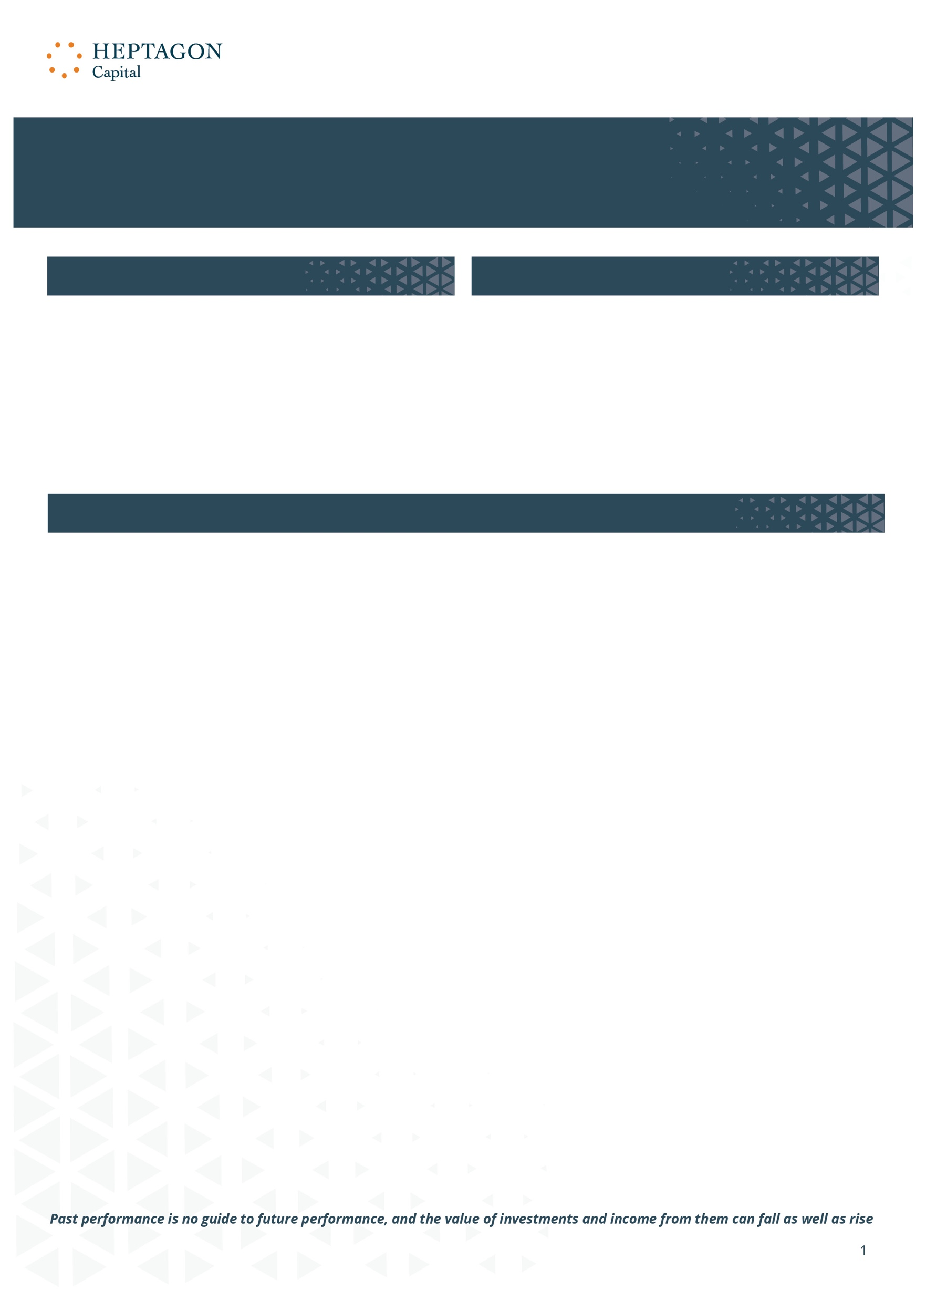







WCM Global Equity Fund
C USD Acc (IE00BYZ09Q19)
Q2 2023
SFDR Classification: Article 8
Fund Manager
ESG Summary
The investment style is a bottom-up approach that seeks to identify companies with attractive attributes, such as long-term historical growth in revenue and earnings, and/or a potential for superior future growth. The investment process, which takes into consideration ESG factors, seeks companies that are industry leaders who are viewed as innovators in their field with business strategies aimed at building on opportunities that have sustainable competitive advantages.
Paul
Black
Mike Trigg
Sanjay
Ayer
Jon Tringale
Exclusions
The Fund will seek to exclude the following business activities in addition to the industries/sub-industries as defined by the Global Industry Classification Standard (“GICS”) industry classification:
I The Fund integrates ESG strategies from across Heptagon’s sustainable investing framework as an intrinsic part of the investment process.
Oil and gas drilling, exploration and production
Coal and consumable fuels
Power generation via fossil fuel combustion
Tobacco
Controversial weapons
Companies who fail to meet corporate culture internal rating criteria
Exclusion Screening
ESG Integration
Company Engagement
MSCI ESG Rating
A
Fund: WCM Global Equity Fund
A
Benchmark: MSCI ACWI
ESG Rating Distribution
MSCI rating data is no guide to future performance and the value of investments and income from them can fall as well as rise.
Please be aware that the use of MSCI’s ESG data constitutes just one part of the Fund’s investment process. Ratings from ESG are only one factor that may influence the ultimate sizing of positions in the Fund. Investors should therefore draw no specific interference between data provided by MSCI and the size of positions held within the Fund.
Source: Heptagon Capital, MSCI ESG Research. ESG Ratings are on a scale of AAA to CCC. Data as of 30/06/2023.

Slide 2
WCM Global Equity Fund
C USD Acc (IE00BYZ09Q19)
Q2 2023
ESG Quality Scorecard
Carbon Risk
Carbon Footprint
 | Carbon Emissions Scope 1+2 | Carbon Intensity Scope 1+2
Fund | 15.8 | 47.7
Benchmark | 102.2 | 130.7
 | (tons CO2e / $M invested) | (tons CO2e / $M sales)
Top 10 Holdings
Company Name | Portfolio Weight | Overall Rating | ESG Rating Momentum | Reputational Risk | Overall ESG Score
Microsoft Corp | 4.0 | AAA | Stable | Moderate | 9.3
Novo Nordisk A/S | 3.9 | AAA | Stable | Moderate | 8.9
Stryker Corp | 3.7 | BBB | Upward | Moderate | 5.4
Amazon.com Inc | 3.6 | A | Upward | Severe | 6.2
Datadog Inc Class A | 3.6 | A | Upward | None | 6.0
Visa Inc Class A | 3.6 | A | Stable | Severe | 7.1
LVMH Moet Hennessy Louis Vuitton SE | 3.6 | AA | Upward | Moderate | 8.3
UnitedHealth Group Inc | 3.5 | AA | Upward | Severe | 8.3
Arthur J. Gallagher & Co | 3.5 | BBB | Stable | Moderate | 4.3
Entegris Inc | 3.3 | A | Stable | None | 5.9
Market Value Coverage
 | ESG Quality | Carbon Risk | Reputational Risk | Governance Risk
Fund | 100% | 100% | 100% | 100%
Benchmark | 100% | 100% | 100% | 100%
MSCI rating data is no guide to future performance and the value of investments and income from them can fall as well as rise.
Please be aware that the use of MSCI’s ESG data constitutes just one part of the Fund’s investment process. Ratings from ESG are only one factor that may influence the ultimate sizing of positions in the Fund. Investors should therefore draw no specific interference between data provided by MSCI and the size of positions held within the Fund.
Source: Heptagon Capital, MSCI ESG Research. Data as of 30/06/2023. MSCI Carbon Metrics include Scope 1+2 emissions and are based on a $1,000,000,000 portfolio allocation. ESG Ratings and Carbon Analytics cover equities held in the portfolio only, excluding cash
Source: Heptagon Capital, MSCI ESG Research. MSCI Carbon Metrics include Scope 1+2 emissions and are based on a $1,000,000,000 portfolio allocation. ESG Ratings and Carbon Analytics cover equities held in the portfolio only, excluding cash.

Slide 3
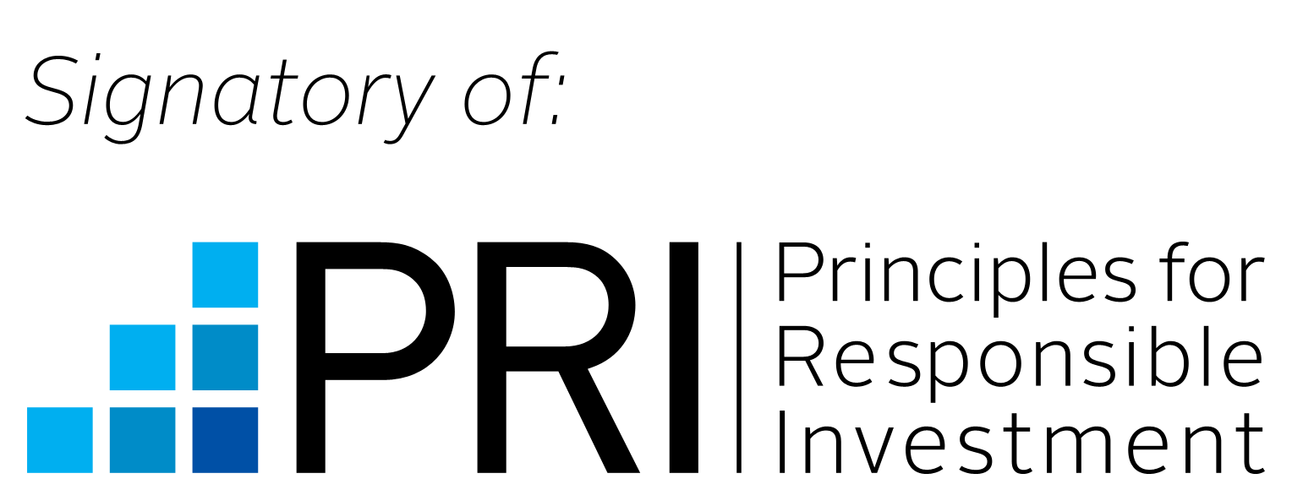
WCM Global Equity Fund
C USD Acc (IE00BYZ09Q19)
Q2 2023
Methodology
ESG Quality Score measures the ability of underlying holdings to manage key medium to long-term risks and opportunities arising from environmental, social, and governance factors. It is based on MSCI ESG Ratings and is measured on a scale of 0 to 10 (worst to best). The distribution of scores is based on the universe of approximately 28,000 funds included in MSCI ESG Fund Metrics.
ESG Ratings Distribution represents the percentage of a portfolio’s market value coming from holdings classified as ESG Ratings Leaders (AAA and AA), Average (A, BBB, and BB), and Laggards (B and CCC).
Carbon Risk measures exposure to carbon intensive companies. It is based on MSCI Carbon Metrics and is calculated as the portfolio weighted average of issuer carbon intensity. At the issuer level, Carbon Intensity is the ratio of annual scope 1 and 2 carbon emissions to annual revenue. Carbon Risk is categorized as Very Low (0 to <15), Low (15 to <70), Moderate (70 to <250), High (250 to <525), and Very High (>=525).
Carbon Emissions - Scope 1+2 Intensity. This figure represents the company's most recently reported or estimated Scope 1 + Scope 2 greenhouse gas emissions normalized by sales in USD (t/USD million sales), which allows for comparison between companies of different sizes.
ESG Ratings Momentum represents the percentage of a portfolio’s market value coming from holdings that have had an ESG Ratings upgrade, and those with a downgrade, since their previous ESG Rating assessment.
Reputational Risk represents the percentage of a portfolio’s market value coming from holdings involved in very severe controversial events. It is based on MSCI ESG Controversies. Portfolio level Reputational Risk is categorized as Very Low (0%), Low (>0% to <1%), Moderate (1% to <5%), High (5% to <10%), and Very High (>=10%).
SFDR
This Fund has been classified as an Article 8 for the purposes of the EU’s Sustainable Finance Disclosure Regulation (‘SFDR’). The Fund promotes environmental and/or social characteristics but does not have sustainable investment as its primary objective. It might invest partially in assets that have a sustainable objective, for instance assets that are qualified as sustainable according to EU classifications but does not place significantly higher importance on the environmental objective of each underlying investment. Please see Prospectus for further information on the Funds environmental and/or social characteristics and relevant sustainability risks and principal adverse impacts which may impact the Fund’s performance.
ESG Credentials
PRI is a leading global network for investors who are committed to integrating environmental, social and governance considerations into their investment practices and ownership policies. The Investment Manager, Heptagon Capital signed the UN PRI on 10th July 2019. The Sub-Investment Manager, WCM Investment Management, signed the UN PRI on 30th January 2019.
Risk warning\s
The Fund is subject to special risk considerations including geographic concentration risk, portfolio concentration risk and operational risk. The investment return and principal value of an investment will fluctuate so that the investor’s shares, when redeemed, may be worth more or less than their original cost. Any investor should consider the investment objectives, risks and charges and expenses of the Fund carefully before investing. Where an investment is denominated in a currency other than the investor’s currency, changes in rates of exchange may have an adverse effect on the value, price of, or income derived from the investment.
MSCI rating data is no guide to future performance and the value of investments and income from them can fall as well as rise.
Please be aware that the use of MSCI’s ESG data constitutes just one part of the Fund’s investment process. Ratings from ESG are only one factor that may influence the ultimate sizing of positions in the Fund. Investors should therefore draw no specific interference between data provided by MSCI and the size of positions held within the Fund.

Slide 4
WCM Global Equity Fund
C USD Acc (IE00BYZ09Q19)
Q2 2023
Important Information and Disclosure
Heptagon Capital Limited, Heptagon Capital LLP and its affiliate companies and its members, officers, employees, agents and advisors disclaim any and all liability relating to these materials, except to the extent required by applicable law or regulations, including, without limitation, any express or implied representations or warranties for statements or errors contained in, and omissions from, these materials. Certain assumptions have been made, and/or parameters set, in the preparation of these materials which have resulted in the returns detailed herein, and no representation or warranty is made that any returns indicated will be achieved. Changes to assumptions or parameters may have a material impact on the returns detailed. This document should not be copied to any other person without our express consent. This document should not be considered an offer to buy or sell investments.
Heptagon Capital Limited has issued this communication as investment manager for Heptagon Fund ICAV (the “ICAV”), an umbrella fund with segregated liability between sub-funds (the “Funds”) and authorised pursuant to the European Communities (Undertakings for Collective Investment in Transferable Securities) Regulations, 2011, as amended, and is licensed to conduct investment services by the Malta Financial Services Authority. Heptagon Capital LLP is authorised and regulated in the UK by the Financial Conduct Authority (FRN: 403304) and is the sub-investment manager for a number of the Funds. Heptagon Capital, 63 Brook Street, Mayfair, London W1K 4HS ~ Tel: +44 20 7070 1800
Representative and Paying Agent in Switzerland is Société Générale, Paris, Zurich branch, Talacker 50, PO Box 1928, 8021 Zurich, Switzerland. The prospectus, the key investor information document, the Articles and the annual and semi-annual reports are available free of charge from the Swiss representative.
The results given in this document are based solely upon historical fund performance as gathered and supplied by Morningstar. That past performance has not been independently verified by either Heptagon Capital Limited or Heptagon Capital LLP. It is not intended to predict or depict the future performance of any investment.
The information contained herein is provided for informational purposes only, is not complete, and does not contain certain material information about the Funds, including important disclosures and risk factors associated with an investment in the Funds. Before making an investment in any Fund, prospective investors are advised to thoroughly and carefully review the ICAV’s prospectus (the “Prospectus”) as well as the supplement to the Prospectus for the Fund and the Fund’s key investor information document with their financial, legal and tax advisors to determine whether an investment is suitable for them. An investment in the Funds is not suitable for all investors.
For all definitions of the financial terms used within this document, please refer to the glossary on our website: https://www.heptagon-capital.com/glossary
Source: MSCI. The MSCI information may only be used for your internal use, may not be reproduced or re-disseminated in any form and may not be used as a basis for or a component of any financial instruments or products or indices. None of the MSCI information is intended to constitute investment advice or a recommendation to make (or refrain from making) any kind of investment decision and may not be relied on as such. Historical data and analysis should not be taken as an indication or guarantee of any future performance analysis, forecast or prediction. The MSCI information is provided on an “as is” basis and the user of this information assumes the entire risk of any use made of this information. MSCI, each of its affiliates and each other person involved in or related to compiling, computing or creating any MSCI information (collectively, the “MSCI Parties”) expressly disclaims all warranties (including, without limitation, any warranties of originality, accuracy, completeness, timeliness, non-infringement, merchantability and fitness for a particular purpose) with respect to this information. Without limiting any of the foregoing, in no event shall any MSCI Party have any liability for any direct, indirect, special, incidental, punitive, consequential (including, without limitation, lost profits) or any other damages. (www.msci.com)
MSCI rating data is no guide to future performance and the value of investments and income from them can fall as well as rise.
Please be aware that the use of MSCI’s ESG data constitutes just one part of the Fund’s investment process. Ratings from ESG are only one factor that may influence the ultimate sizing of positions in the Fund. Investors should therefore draw no specific interference between data provided by MSCI and the size of positions held within the Fund.

Slide 5
WCM Global Equity Fund
C USD Acc (IE00BYZ09Q19)
Q2 2023
This disclosure was developed using information from MSCI ESG Research LLC or its affiliates or information providers. Although Heptagon Fund ICAV information providers, including without limitation, MSCI ESG Research LLC and its affiliates (the “ESG Parties”), obtain information (the “Information”) from sources they consider reliable, none of the ESG Parties warrants or guarantees the originality, accuracy and/or completeness, of any data herein and expressly disclaim all express or implied warranties, including those of merchantability and fitness for a particular purpose. The Information may only be used for your internal use, may not be reproduced or re-disseminated in any form and may not be used as a basis for, or a component of, any financial instruments or products or indices. Further, none of the Information can in and of itself be used to determine which securities to buy or sell or when to buy or sell them. None of the ESG Parties shall have any liability for any errors or omissions in connection with any data herein, or any liability for any direct, indirect, special, punitive, consequential or any other damages (including lost profits) even if notified of the possibility of such damages.
MSCI rating data is no guide to future performance and the value of investments and income from them can fall as well as rise.
Heptagon Capital, 63 Brook Street, Mayfair, London W1K 4HS
Tel: +44 20 7070 1800
(FRN 403304)
Authorised & Regulated by the Financial Conduct Authority in the UK
12 Endeavour Square, London, E20 1JN

